Slide 1

Quality Management Overview
Date: 12th FEB 2025
Time: 3:30 PM to 4:30 PM
Duration: 1 Hours
Trainer: Sivaramasundaram K

Slide 2
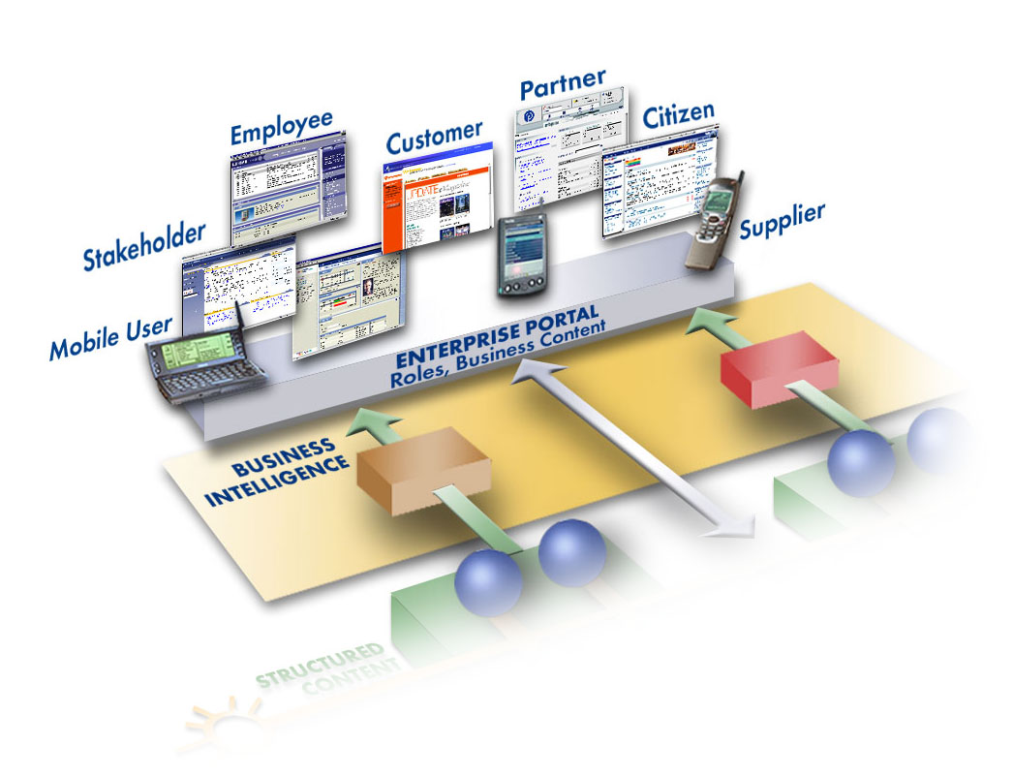
Agenda
Quality Management - Introduction
QM Process Overview
Quality Planning
Quality Inspection
Quality Notification
Quality Certificate
QM Integration
Question and Answers
2
Notes:
2

Slide 3
Quality Management - Introduction
SAP QM module will be a strategic management tool from quality planning to quality evaluation
Quality Management will be used to store and manage quality related data throughout the supply chain.
The QM module will handle the traditional tasks of quality planning, quality inspections, quality certificates, quality notifications, and quality control
Continuous process and product improvement
In SAP we can implement the most important elements of a QM system.
3

Slide 4
QM Component Overview
Quality
Certificate & Reports
Quality
Certificate & Reports
Quality
Planning
Quality
Inspection
Usage
Decision
Quality
Notification
Basic data - building blocks
Material master
Inspection characteristics
Sampling Procedure
Inspection plans
Inspection lot creation
Results recording
Defects recording
Accept or Reject decision
Stock postings
Activate Notifications
Notification created
Defects
Tasks
Activities
Notification
completed
Certificate
Reports
4

Slide 5
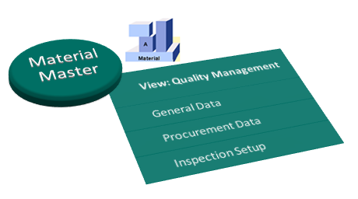
Material Master
Material Master is a structure of basic data of the Product. It used in Purchasing, Sales and Distribution, Production, QM, Warehouse Management and Accounts related data.
Notes:
Master Data:
Master data is the core data that is essential to operations in a specific business or business unit. The kinds of information treated as master data varies from one industry to another and even from one company to another within the same industry.
Material Master Data
It is a structure of basic data of the Product. Used in Purchasing, Sales and Distribution, Production, QM, Warehouse Management and Accounts related data. Under QM, the view consists of QM Material Authorization, Catalogue Profile, QM Procurement Active, Certificate type, and Inspection Set up.
Master Inspection Characteristic
Master Inspection characteristic describes WHAT needs to be inspected.
It can be either Qualitative or Quantitative and intended for repetitive use
Inspection Method
An inspection method describes how a characteristic is to be inspected. You can assign documents that are stored in a document management system (such as drawings and descriptions) to an inspection method.
Sampling Procedure
A sampling procedure defines the rules that specify how the system calculates the sample size and it contains information about the valuation of an inspection characteristic during results recording (attributive, variable, manual, etc.). Sampling procedures are usually used at characteristic level of a Inspection Plan.
Dynamic Modification Rule
The dynamic modification rule used to change the inspection stage (Tightened, Normal, Reduced and Skip Inspection) dynamically based on goods condition.
Work Centre
In Quality Management, Work centre refers to a person or a group of people which carry out the Quality activities in the plant.
The work center specifies where an operation is to be performed and who should process it.
Inspection Plan
The inspection plan defines the inspection criteria for a material and through which only all inspection activity will be carried out. It is consists of material to be inspected, Work center, characteristics to be inspected, required test method, sampling procedure, inspection characteristics unit of measurement, decimal point and specification of inspection characteristics.
Catalog
A catalog is a summary of codes for content-related terms. Catalogs can make it easy to uniformly describe qualitative data (for example, attributes for
qualitative characteristics, defect types, or usage decisions).

Slide 6
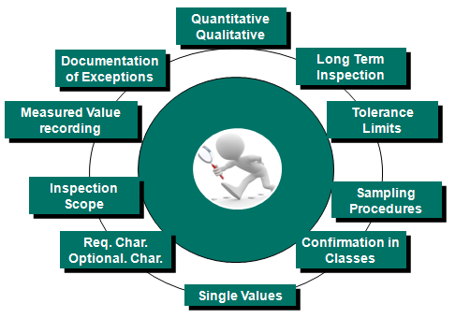
Master Inspection Characteristic
Master Inspection characteristic describes WHAT needs to be inspected.
Notes:
Master Data:
Master data is the core data that is essential to operations in a specific business or business unit. The kinds of information treated as master data varies from one industry to another and even from one company to another within the same industry.
Material Master Data
It is a structure of basic data of the Product. Used in Purchasing, Sales and Distribution, Production, QM, Warehouse Management and Accounts related data. Under QM, the view consists of QM Material Authorization, Catalogue Profile, QM Procurement Active, Certificate type, and Inspection Set up.
Master Inspection Characteristic
Master Inspection characteristic describes WHAT needs to be inspected.
It can be either Qualitative or Quantitative and intended for repetitive use
Inspection Method
An inspection method describes how a characteristic is to be inspected. You can assign documents that are stored in a document management system (such as drawings and descriptions) to an inspection method.
Sampling Procedure
A sampling procedure defines the rules that specify how the system calculates the sample size and it contains information about the valuation of an inspection characteristic during results recording (attributive, variable, manual, etc.). Sampling procedures are usually used at characteristic level of a Inspection Plan.
Dynamic Modification Rule
The dynamic modification rule used to change the inspection stage (Tightened, Normal, Reduced and Skip Inspection) dynamically based on goods condition.
Work Centre
In Quality Management, Work centre refers to a person or a group of people which carry out the Quality activities in the plant.
The work center specifies where an operation is to be performed and who should process it.
Inspection Plan
The inspection plan defines the inspection criteria for a material and through which only all inspection activity will be carried out. It is consists of material to be inspected, Work center, characteristics to be inspected, required test method, sampling procedure, inspection characteristics unit of measurement, decimal point and specification of inspection characteristics.
Catalog
A catalog is a summary of codes for content-related terms. Catalogs can make it easy to uniformly describe qualitative data (for example, attributes for
qualitative characteristics, defect types, or usage decisions).

Slide 7
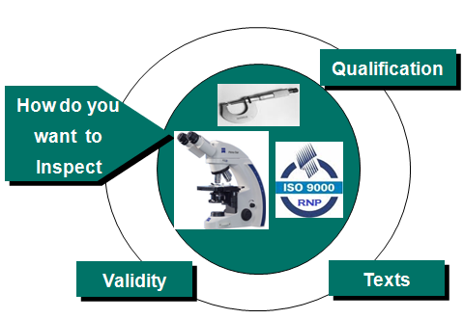
Inspection Method
An inspection method describes how a characteristic is to be inspected.
Notes:
Master Data:
Master data is the core data that is essential to operations in a specific business or business unit. The kinds of information treated as master data varies from one industry to another and even from one company to another within the same industry.
Material Master Data
It is a structure of basic data of the Product. Used in Purchasing, Sales and Distribution, Production, QM, Warehouse Management and Accounts related data. Under QM, the view consists of QM Material Authorization, Catalogue Profile, QM Procurement Active, Certificate type, and Inspection Set up.
Master Inspection Characteristic
Master Inspection characteristic describes WHAT needs to be inspected.
It can be either Qualitative or Quantitative and intended for repetitive use
Inspection Method
An inspection method describes how a characteristic is to be inspected. You can assign documents that are stored in a document management system (such as drawings and descriptions) to an inspection method.
Sampling Procedure
A sampling procedure defines the rules that specify how the system calculates the sample size and it contains information about the valuation of an inspection characteristic during results recording (attributive, variable, manual, etc.). Sampling procedures are usually used at characteristic level of a Inspection Plan.
Dynamic Modification Rule
The dynamic modification rule used to change the inspection stage (Tightened, Normal, Reduced and Skip Inspection) dynamically based on goods condition.
Work Centre
In Quality Management, Work centre refers to a person or a group of people which carry out the Quality activities in the plant.
The work center specifies where an operation is to be performed and who should process it.
Inspection Plan
The inspection plan defines the inspection criteria for a material and through which only all inspection activity will be carried out. It is consists of material to be inspected, Work center, characteristics to be inspected, required test method, sampling procedure, inspection characteristics unit of measurement, decimal point and specification of inspection characteristics.
Catalog
A catalog is a summary of codes for content-related terms. Catalogs can make it easy to uniformly describe qualitative data (for example, attributes for
qualitative characteristics, defect types, or usage decisions).

Slide 8
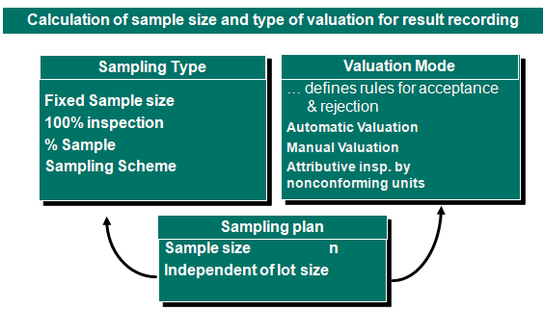
Sampling Procedure
A sampling procedure defines the rules that specify how the system calculates the sample size and it contains information about the valuation of an inspection characteristic during results recording (attributive, variable, manual, etc.).
Notes:
Master Data:
Master data is the core data that is essential to operations in a specific business or business unit. The kinds of information treated as master data varies from one industry to another and even from one company to another within the same industry.
Material Master Data
It is a structure of basic data of the Product. Used in Purchasing, Sales and Distribution, Production, QM, Warehouse Management and Accounts related data. Under QM, the view consists of QM Material Authorization, Catalogue Profile, QM Procurement Active, Certificate type, and Inspection Set up.
Master Inspection Characteristic
Master Inspection characteristic describes WHAT needs to be inspected.
It can be either Qualitative or Quantitative and intended for repetitive use
Inspection Method
An inspection method describes how a characteristic is to be inspected. You can assign documents that are stored in a document management system (such as drawings and descriptions) to an inspection method.
Sampling Procedure
A sampling procedure defines the rules that specify how the system calculates the sample size and it contains information about the valuation of an inspection characteristic during results recording (attributive, variable, manual, etc.). Sampling procedures are usually used at characteristic level of a Inspection Plan.
Dynamic Modification Rule
The dynamic modification rule used to change the inspection stage (Tightened, Normal, Reduced and Skip Inspection) dynamically based on goods condition.
Work Centre
In Quality Management, Work centre refers to a person or a group of people which carry out the Quality activities in the plant.
The work center specifies where an operation is to be performed and who should process it.
Inspection Plan
The inspection plan defines the inspection criteria for a material and through which only all inspection activity will be carried out. It is consists of material to be inspected, Work center, characteristics to be inspected, required test method, sampling procedure, inspection characteristics unit of measurement, decimal point and specification of inspection characteristics.
Catalog
A catalog is a summary of codes for content-related terms. Catalogs can make it easy to uniformly describe qualitative data (for example, attributes for
qualitative characteristics, defect types, or usage decisions).

Slide 9
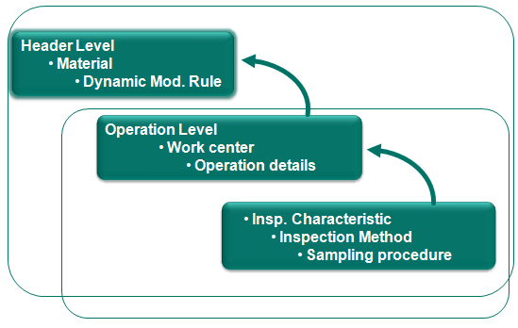
Inspection Plan
Inspection Plans is used to describe how a quality inspection should be performed for one or more materials.
Notes:
Master Data:
Master data is the core data that is essential to operations in a specific business or business unit. The kinds of information treated as master data varies from one industry to another and even from one company to another within the same industry.
Material Master Data
It is a structure of basic data of the Product. Used in Purchasing, Sales and Distribution, Production, QM, Warehouse Management and Accounts related data. Under QM, the view consists of QM Material Authorization, Catalogue Profile, QM Procurement Active, Certificate type, and Inspection Set up.
Master Inspection Characteristic
Master Inspection characteristic describes WHAT needs to be inspected.
It can be either Qualitative or Quantitative and intended for repetitive use
Inspection Method
An inspection method describes how a characteristic is to be inspected. You can assign documents that are stored in a document management system (such as drawings and descriptions) to an inspection method.
Sampling Procedure
A sampling procedure defines the rules that specify how the system calculates the sample size and it contains information about the valuation of an inspection characteristic during results recording (attributive, variable, manual, etc.). Sampling procedures are usually used at characteristic level of a Inspection Plan.
Dynamic Modification Rule
The dynamic modification rule used to change the inspection stage (Tightened, Normal, Reduced and Skip Inspection) dynamically based on goods condition.
Work Centre
In Quality Management, Work centre refers to a person or a group of people which carry out the Quality activities in the plant.
The work center specifies where an operation is to be performed and who should process it.
Inspection Plan
The inspection plan defines the inspection criteria for a material and through which only all inspection activity will be carried out. It is consists of material to be inspected, Work center, characteristics to be inspected, required test method, sampling procedure, inspection characteristics unit of measurement, decimal point and specification of inspection characteristics.
Catalog
A catalog is a summary of codes for content-related terms. Catalogs can make it easy to uniformly describe qualitative data (for example, attributes for
qualitative characteristics, defect types, or usage decisions).

Slide 10
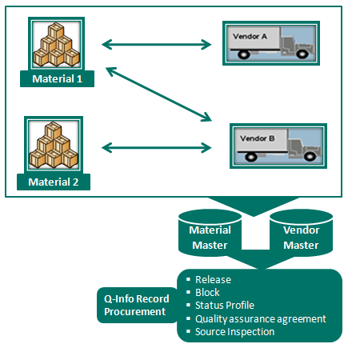
Quality Info Record
When a quotation or purchase order is created, the system checks whether a Q-info record is required and available for the combination of material and vendor. A check is made to determine whether the purchase order can be released.
Notes:
Master Data:
Master data is the core data that is essential to operations in a specific business or business unit. The kinds of information treated as master data varies from one industry to another and even from one company to another within the same industry.
Material Master Data
It is a structure of basic data of the Product. Used in Purchasing, Sales and Distribution, Production, QM, Warehouse Management and Accounts related data. Under QM, the view consists of QM Material Authorization, Catalogue Profile, QM Procurement Active, Certificate type, and Inspection Set up.
Master Inspection Characteristic
Master Inspection characteristic describes WHAT needs to be inspected.
It can be either Qualitative or Quantitative and intended for repetitive use
Inspection Method
An inspection method describes how a characteristic is to be inspected. You can assign documents that are stored in a document management system (such as drawings and descriptions) to an inspection method.
Sampling Procedure
A sampling procedure defines the rules that specify how the system calculates the sample size and it contains information about the valuation of an inspection characteristic during results recording (attributive, variable, manual, etc.). Sampling procedures are usually used at characteristic level of a Inspection Plan.
Dynamic Modification Rule
The dynamic modification rule used to change the inspection stage (Tightened, Normal, Reduced and Skip Inspection) dynamically based on goods condition.
Work Centre
In Quality Management, Work centre refers to a person or a group of people which carry out the Quality activities in the plant.
The work center specifies where an operation is to be performed and who should process it.
Inspection Plan
The inspection plan defines the inspection criteria for a material and through which only all inspection activity will be carried out. It is consists of material to be inspected, Work center, characteristics to be inspected, required test method, sampling procedure, inspection characteristics unit of measurement, decimal point and specification of inspection characteristics.
Catalog
A catalog is a summary of codes for content-related terms. Catalogs can make it easy to uniformly describe qualitative data (for example, attributes for
qualitative characteristics, defect types, or usage decisions).

Slide 11
Catalog
We use catalogs to manage, uniformly define and standardize information. It can help us to record and subsequently evaluate qualitative data, describe problems.
For Example: In Cutting Section - Defects
1. Scratch,
2. Thickness variation,
3. Damage
In Welding Section -Defects
1.Over welded
2.Flux Over used
Notes:
Master Data:
Master data is the core data that is essential to operations in a specific business or business unit. The kinds of information treated as master data varies from one industry to another and even from one company to another within the same industry.
Material Master Data
It is a structure of basic data of the Product. Used in Purchasing, Sales and Distribution, Production, QM, Warehouse Management and Accounts related data. Under QM, the view consists of QM Material Authorization, Catalogue Profile, QM Procurement Active, Certificate type, and Inspection Set up.
Master Inspection Characteristic
Master Inspection characteristic describes WHAT needs to be inspected.
It can be either Qualitative or Quantitative and intended for repetitive use
Inspection Method
An inspection method describes how a characteristic is to be inspected. You can assign documents that are stored in a document management system (such as drawings and descriptions) to an inspection method.
Sampling Procedure
A sampling procedure defines the rules that specify how the system calculates the sample size and it contains information about the valuation of an inspection characteristic during results recording (attributive, variable, manual, etc.). Sampling procedures are usually used at characteristic level of a Inspection Plan.
Dynamic Modification Rule
The dynamic modification rule used to change the inspection stage (Tightened, Normal, Reduced and Skip Inspection) dynamically based on goods condition.
Work Centre
In Quality Management, Work centre refers to a person or a group of people which carry out the Quality activities in the plant.
The work center specifies where an operation is to be performed and who should process it.
Inspection Plan
The inspection plan defines the inspection criteria for a material and through which only all inspection activity will be carried out. It is consists of material to be inspected, Work center, characteristics to be inspected, required test method, sampling procedure, inspection characteristics unit of measurement, decimal point and specification of inspection characteristics.
Catalog
A catalog is a summary of codes for content-related terms. Catalogs can make it easy to uniformly describe qualitative data (for example, attributes for
qualitative characteristics, defect types, or usage decisions).

Slide 12

Quality Inspection
Record results and determine whether the inspected material fulfills the quality requirements.
12

Slide 13
Quality Inspection
Pur. Goods
Receipt
Production
order
Quality
Goods
Inspection
inspection
issue
lot
Delivery
Manual
13

Slide 14

Defect Recording
Manually
ü
Usage decision
Results recording
Defects recording
Quality notification
Quality notification
14

Slide 15
Stock Posting
Unrestricted stock type
Back to the vendor
Blocked stock
Scrap
New Material
ü
X
15

Slide 16
Quality Notification
Record and process internal and external problems that are primarily caused by poor-quality goods or services.
Procurement
Production
Sales & Dist
Complaints against the vendor
Problem notifications
Customer complaints
Continuous process improvements
16

Slide 17
Quality Notification
Process Flow
Activities
tasks
results
Problem Notification
Analysis
Solutions
defects
caused by...
17

Slide 18
Quality Certificate
Certify the quality of a material
Quality certificates contain texts,
specification values, and inspection results.
Quality certificate
Material
Batch
Incoming Quality Certificate
Outgoing Certificate
A certificate can be created against
inspection lot or batch or production lot
Characs. ................. ................. .................
18

Slide 19

Quality Integration
Procurement
Production
IN
Sales & Distribution
Quality Management
Plant Maintenance
MII
19

Slide 20
Quality Integration
QM in Procurement
Goods Receipt Inspection
Vendor Complaint
Block the vendor
Test Certificate from vendor
Purchase Order
20

Slide 21
Quality Integration
QM in Production
In-Process Inspection
Online inspection
Hourly Inspection
Shift wise inspection
Final Inspection
Production Defect
Manufacturing
21

Slide 22
Quality Integration
QM in Sales and Distribution
Dispatch
Delivery Level Inspection
Customer Return processing
Customer complaint processing
22

Slide 23
Quality Management - Benefits
SAP QM module will be a strategic management tool from quality planning to quality evaluation.
Manages problems using quality notifications and processes complaints against the vendor.
Evaluates vendors on the basis of quality using quality scores from audits, goods receipt inspections, and problem notifications.
Handles inspection characteristics and setup characteristics for operations.
Confirms quality and quantity information for manufacturing orders.
Standardized methodology for complaint reporting and analysis.
Calibration frequency scheduled by system for instruments.
Standard reports for analysis and review.
23

Slide 24
Question Answers
Thank You for your Kind Attention
24

